Slide 1
Searching & Sorting

Slide 2
SEARCHING: linear search
Given an array arr[] of n elements, write a function to search a given element x in arr[]. A simple approach is to do linear search, i.e
Start from the leftmost element of arr[] and one by one compare x with each element of arr[]
If x matches with an element, return the index.
If x doesn’t match with any of elements, return -1.
Refer Program here

Slide 3
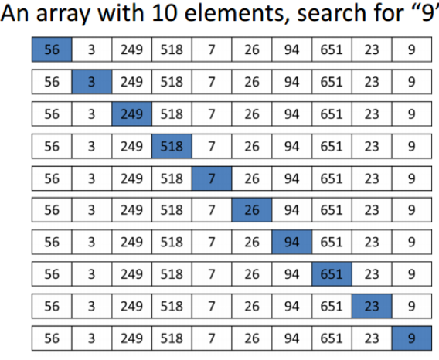

Slide 4
linear search
Linear search is rarely used practically because other search algorithms such as the binary search algorithm and hash tables allow significantly faster searching comparison to Linear search.
Performance
Number of comparisons made in searching a record determines the efficiency of the technique
The worst case efficiency of this algorithm is O(n)

Slide 5
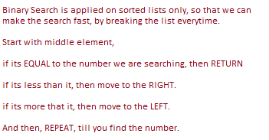
Binary search
Given a sorted array arr[] of n elements, write a function to search a given element item in arr[].
Binary Search
Refer program here

Slide 6
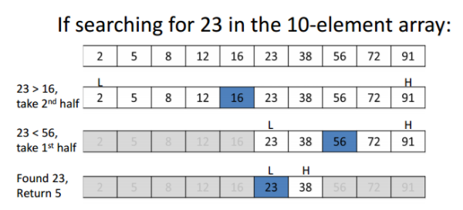

Slide 7
Linear Search vs Binary Search
Important Differences
Input data needs to be sorted in Binary Search and not in Linear Search
Linear search does the sequential access whereas Binary search access data randomly.
Time complexity of linear search O(n) , Binary search has time complexity O(log n).
Notes:
how many times can you divide N by 2 until you have 1? This is essentially saying, do a binary search (half the elements) until you found it. In a formula this would be this:
1 = N / 2^{x}
multiply by 2^{x}:
2^{x} = N
now do the log₂:
log₂(2^{x}) = log₂ N x * log₂(2) = log₂ N x * 1 = log₂ N
this means you can divide log N times until you have everything divided. Which means you have to divide log N ("do the binary search step") until you found your element.

Slide 8
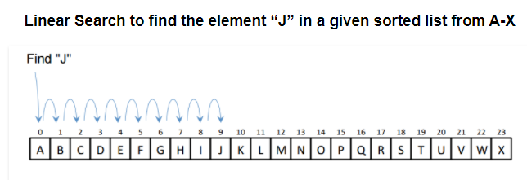

Slide 9
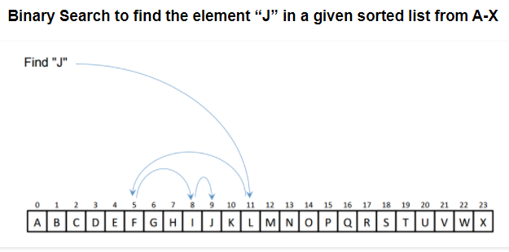
Linear Search vs Binary Search

Slide 10
Sorting
Sorting is the process of arranging the data in some logical order.
This logical order may be ascending or descending in case of numeric values or dictionary order in case of alphanumeric values.

Slide 11
Categories of Sorting
The techniques of sorting can be divided into two categories. These are:
Internal Sorting
External Sorting

Slide 12
Internal Sorting: If all the data that is to be sorted can be adjusted at a time in main memory, the internal sorting method is being performed.
Bubble sort, Insertion sort, Selection sort, Quick sort, Heap sort are examples of internal sorting.
External Sorting: When the data that is to be sorted cannot be accommodated in the memory at the same time and some has to be kept in auxiliary memory such as hard disk, floppy disk, magnetic tapes etc., then external sorting methods are performed.
Merge sort is an example of external sorting.

Slide 13
Complexity of Sorting Algorithms
The complexity of sorting algorithm calculates the running time of a function in which 'n' number of items are to be sorted. The choice for which sorting method is suitable for a problem depends on several dependency configurations for different problems. The most noteworthy of these considerations are:
The length of time spent by the programmer in programming a specific sorting program
Amount of machine time necessary for running the program
The amount of memory necessary for running the program

Slide 14
Types of Sorting Techniques
Bubble Sort
Selection Sort
Insertion Sort
Quick Sort
Heap Sort
Merge Sort

Slide 15
Bubble sort
Bubble Sort is the simplest sorting algorithm that works by repeatedly swapping the adjacent elements if they are in wrong order.
Worst and Average Case Time Complexity: O(n*n). Worst case occurs when array is reverse sorted.
Best Case Time Complexity: O(n). Best case occurs when array is already sorted.
Refer Program here

Slide 16
Auxiliary space: O(1)
Stable: Yes
Sorting In place: Yes

Slide 17
Modified bubble sort
Optimized Implementation: The above function always runs O(n^2) time even if the array is sorted. It can be optimized by stopping the algorithm if inner loop didn’t cause any swap.
Refer Program here

Slide 18
SELECTION SORT
The selection sort algorithm sorts an array by repeatedly finding the minimum element (considering ascending order) from unsorted part and putting it at the beginning. The algorithm maintains two subarrays in a given array.
1) The subarray which is already sorted. 2) Remaining subarray which is unsorted.
In every iteration of selection sort, the minimum element (considering ascending order) from the unsorted subarray is picked and moved to the sorted subarray.
Refer Program here

Slide 19
Worst, Average and Best Case Time Complexity: O(n*n). Worst case occurs when array is reverse sorted.
Auxiliary space: O(1)
Stable: No
Sorting In place: Yes

Slide 20
Insertion Sort
It is a simple Sorting algorithm which sorts the array by shifting elements one by one. Following are some of the important characteristics of Insertion Sort.
It has one of the simplest implementation
It is efficient for smaller data sets, but very inefficient for larger lists.
Insertion Sort is adaptive, that means it reduces its total number of steps if given a partially sorted list, hence it increases its efficiency.
Refer Program here

Slide 21
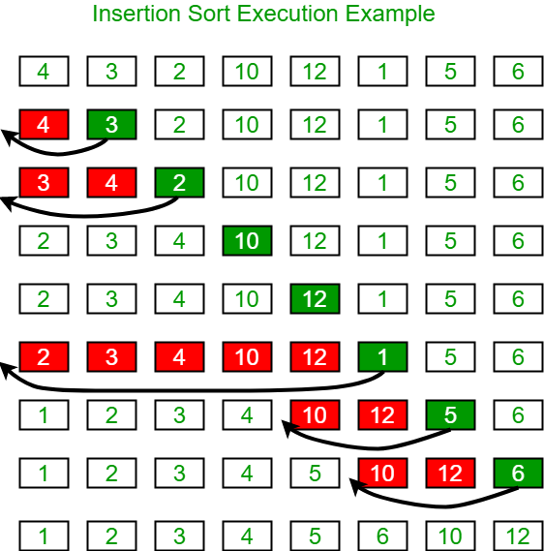

Slide 22
Worst and Average Case Time Complexity: O(n*n). Worst case occurs when array is reverse sorted.
Best Case Time Complexity: O(n). Best case occurs when array is already sorted.
Auxiliary space: O(1)
Stable: Yes
Sorting In place: Yes

Slide 23
Merge Sort
Merge Sort is a Divide and Conquer algorithm.
It divides input array in two halves, calls itself for the two halves and then merges the two sorted halves.
The merge() function is used for merging two halves. The merge(arr, l, m, r) is key process that assumes that arr[l..m] and arr[m+1..r] are sorted and merges the two sorted sub-arrays into one.

Slide 24
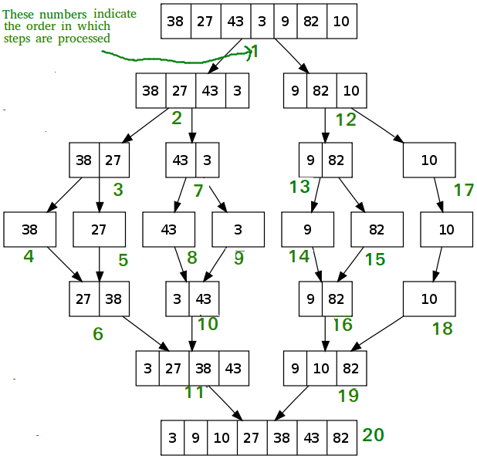

Slide 26
Worst, Average and Best Case Time Complexity: O(n log n). Worst case occurs when array is reverse sorted.
Auxiliary space: O(n)
Stable: Yes
Sorting In place: No

Slide 27
Quick Sort
Like Merge Sort, QuickSort is a Divide and Conquer algorithm. It picks an element as pivot and partitions the given array around the picked pivot. There are many different versions of quickSort that pick pivot in different ways.
Always pick first element as pivot.
Always pick last element as pivot (implemented below)
Pick a random element as pivot.
Pick median as pivot.
The key process in quickSort is partition(). Target of partitions is, given an array and an element x of array as pivot, put x at its correct position in sorted array and put all smaller elements (smaller than x) before x, and put all greater elements (greater than x) after x.
All this should be done in linear time.

Slide 28
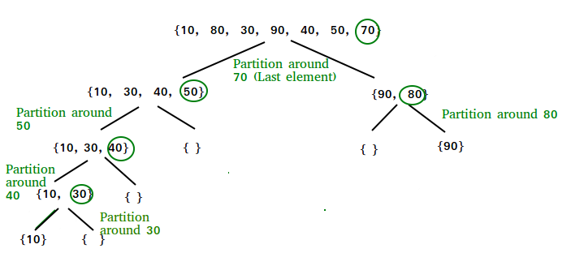

Slide 29
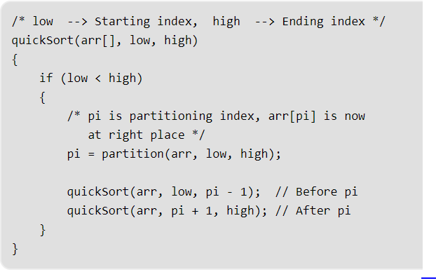
Quicksort function

Slide 30
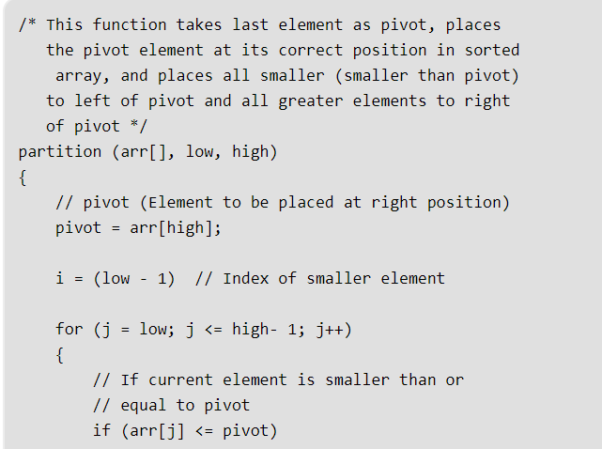
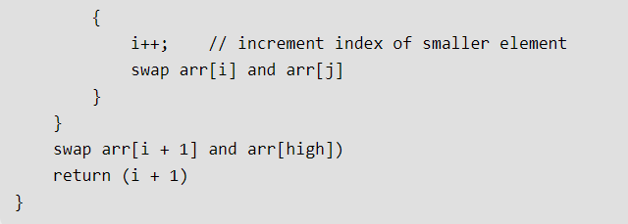

Slide 32
Worst Case Time Complexity: O(n*n). Worst case occurs when array is reverse sorted.
Best Case and Average Case Time Complexity: O(n log n). Best case occurs when array is already sorted.
Auxiliary space: O(1)
Stable: No
Sorting In place: Yes

Slide 33
Heap
A Binary Heap is a Binary Tree with following properties. 1) It’s a complete tree (All levels are completely filled except possibly the last level and the last level has all keys as left as possible). This property of Binary Heap makes them suitable to be stored in an array.
2) A Binary Heap is either Min Heap or Max Heap. In a Min Binary Heap, the key at root must be minimum among all keys present in Binary Heap. The same property must be recursively true for all nodes in Binary Tree.

Slide 34
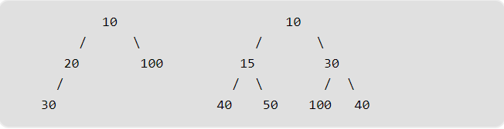
Examples of Min-Heap

Slide 35
Heap Sort
Heap sort is a comparison based sorting technique based on Binary Heap data structure. It is similar to selection sort where we first find the maximum element and place the maximum element at the end.
We repeat the same process for remaining element.

Slide 36
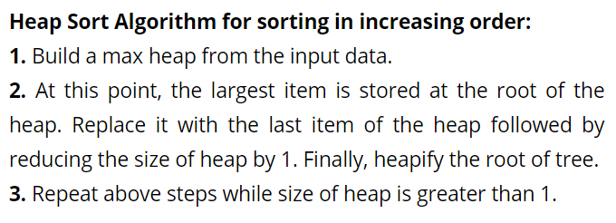

Slide 38
Worst, Average and Best Case Time Complexity: O(n log n). Worst case occurs when array is reverse sorted.
Auxiliary space: O(1)
Stable: No
Sorting In place: Yes

